Slide 1
SimCLR Results

Slide 2
SimCLR Augmentation Pipeline
Random Resized Crop (p=1.0)
Training: Scale 0.08 to 1.0. Forces the model to map local features (e.g., an eye) to global facial geometry.
Testing: Scale 0.6 to 1.0. Preserves core facial structure to strictly evaluate identity matching. I decreased it because the results were too bad with cropping ranging from 8% to 100%.
Color Jitter (p=0.8)
Randomly shifts Brightness, Contrast, and Saturation by up to ±80%, and Hue by ±20%.
Random Grayscale (p=0.2)
Gaussian Blur (p=1.0)
Applied via a 9×9 kernel.
Horizontal Flip (p=0.5)
Mirrors the image left-to-right to ensure spatial invariance.

Slide 3
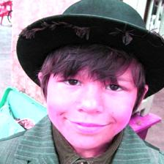
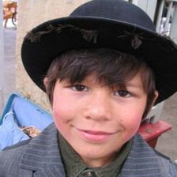
Image 1: Cosine Similarity: 0.9947

Slide 4
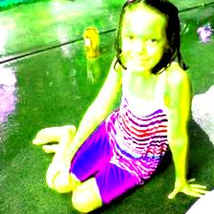
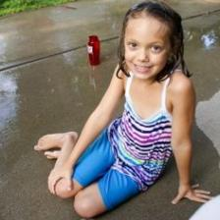
Image 2: Cosine Similarity: 0.9061

Slide 5
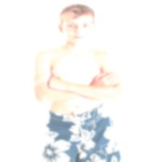
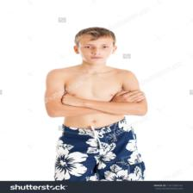
Image 3: Cosine Similarity = 0.4845

Slide 6
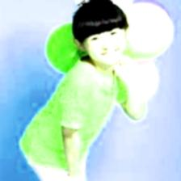
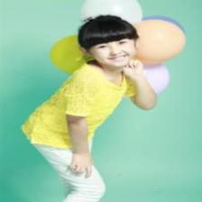
Image 4: Cosine Similarity: 0.8524

Slide 7
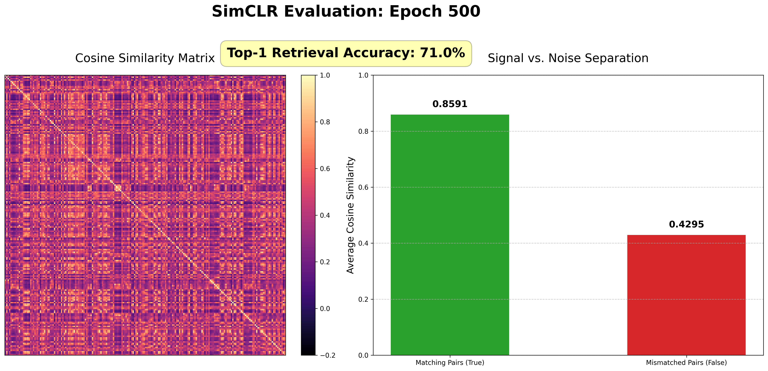
Epoch 500

Slide 8
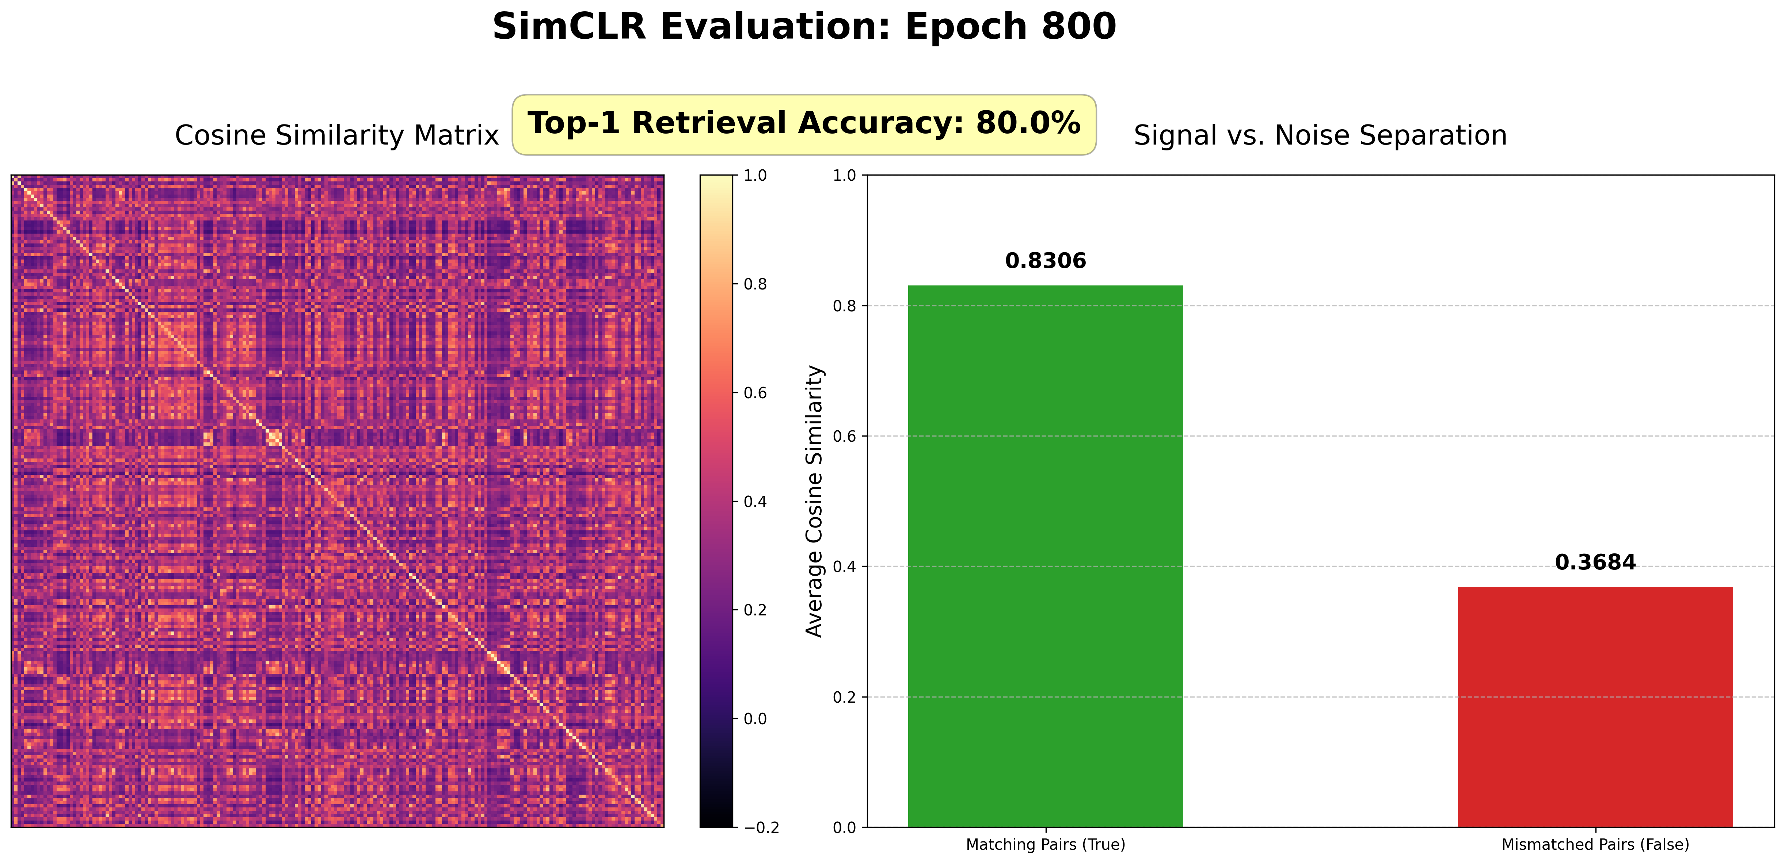
Epoch 800

Slide 9
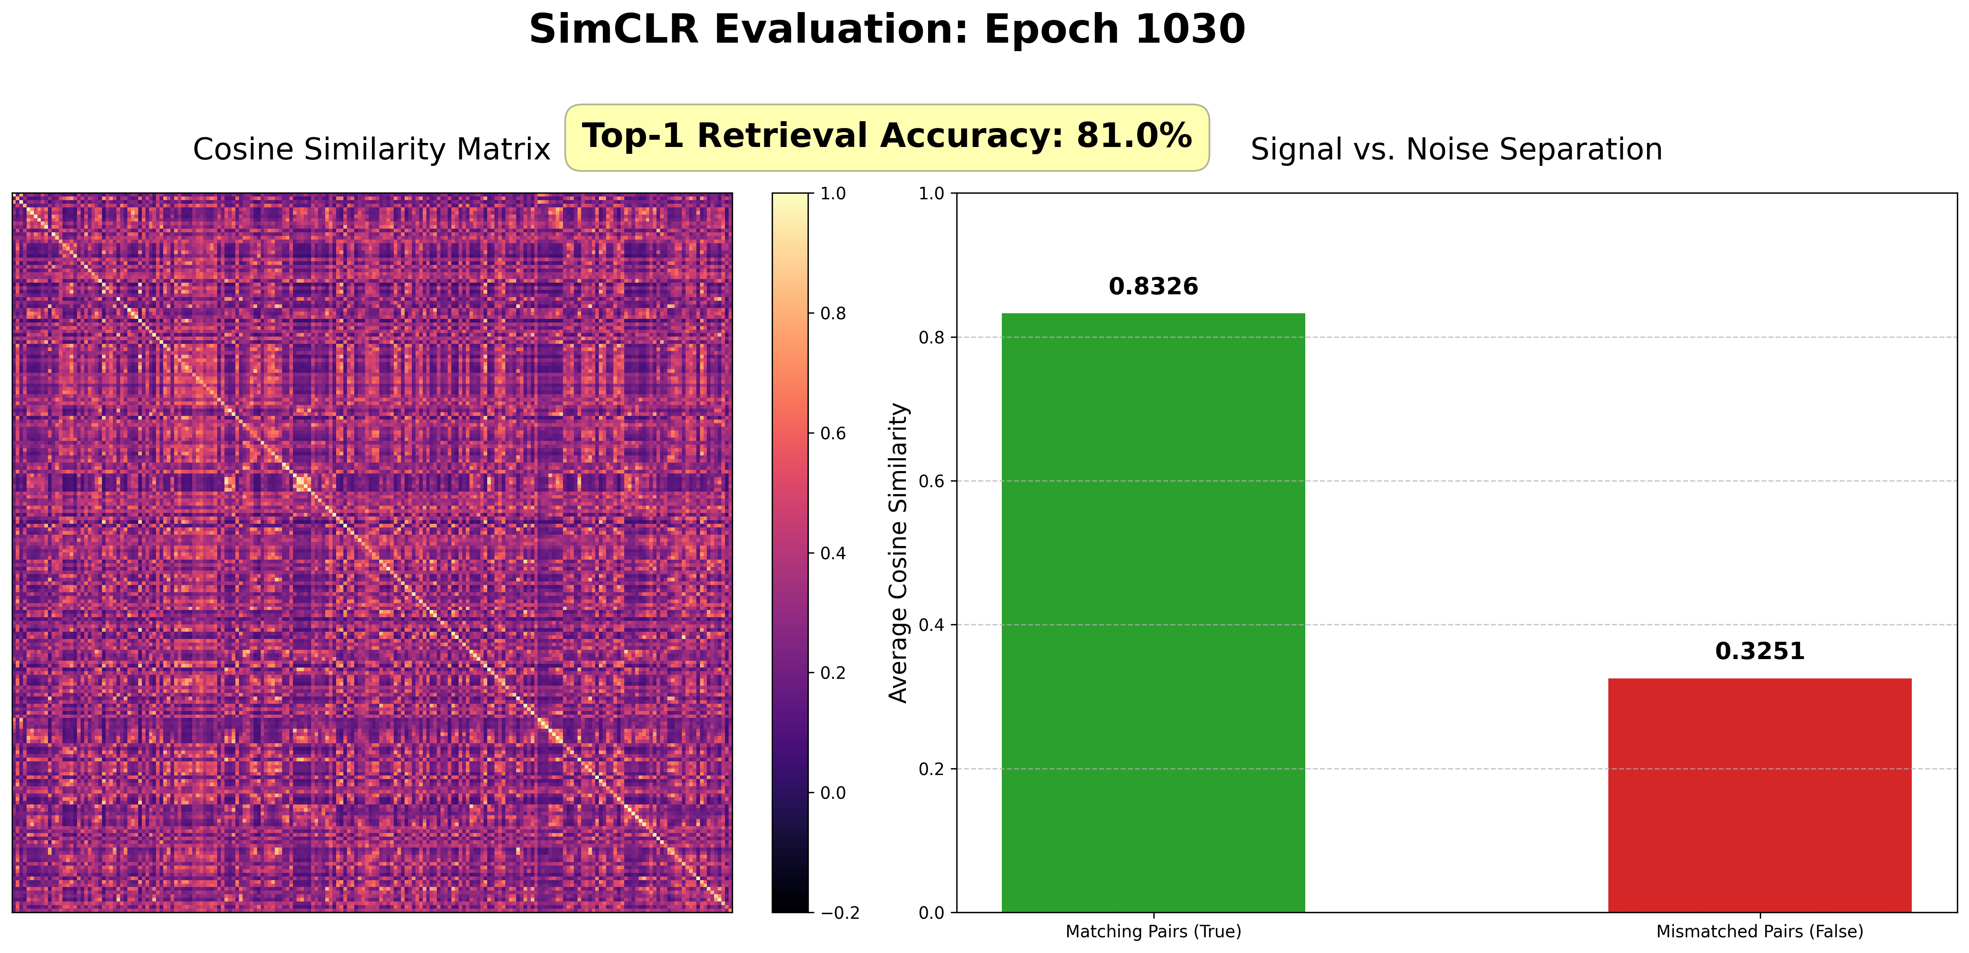
Epoch 1030

Slide 10
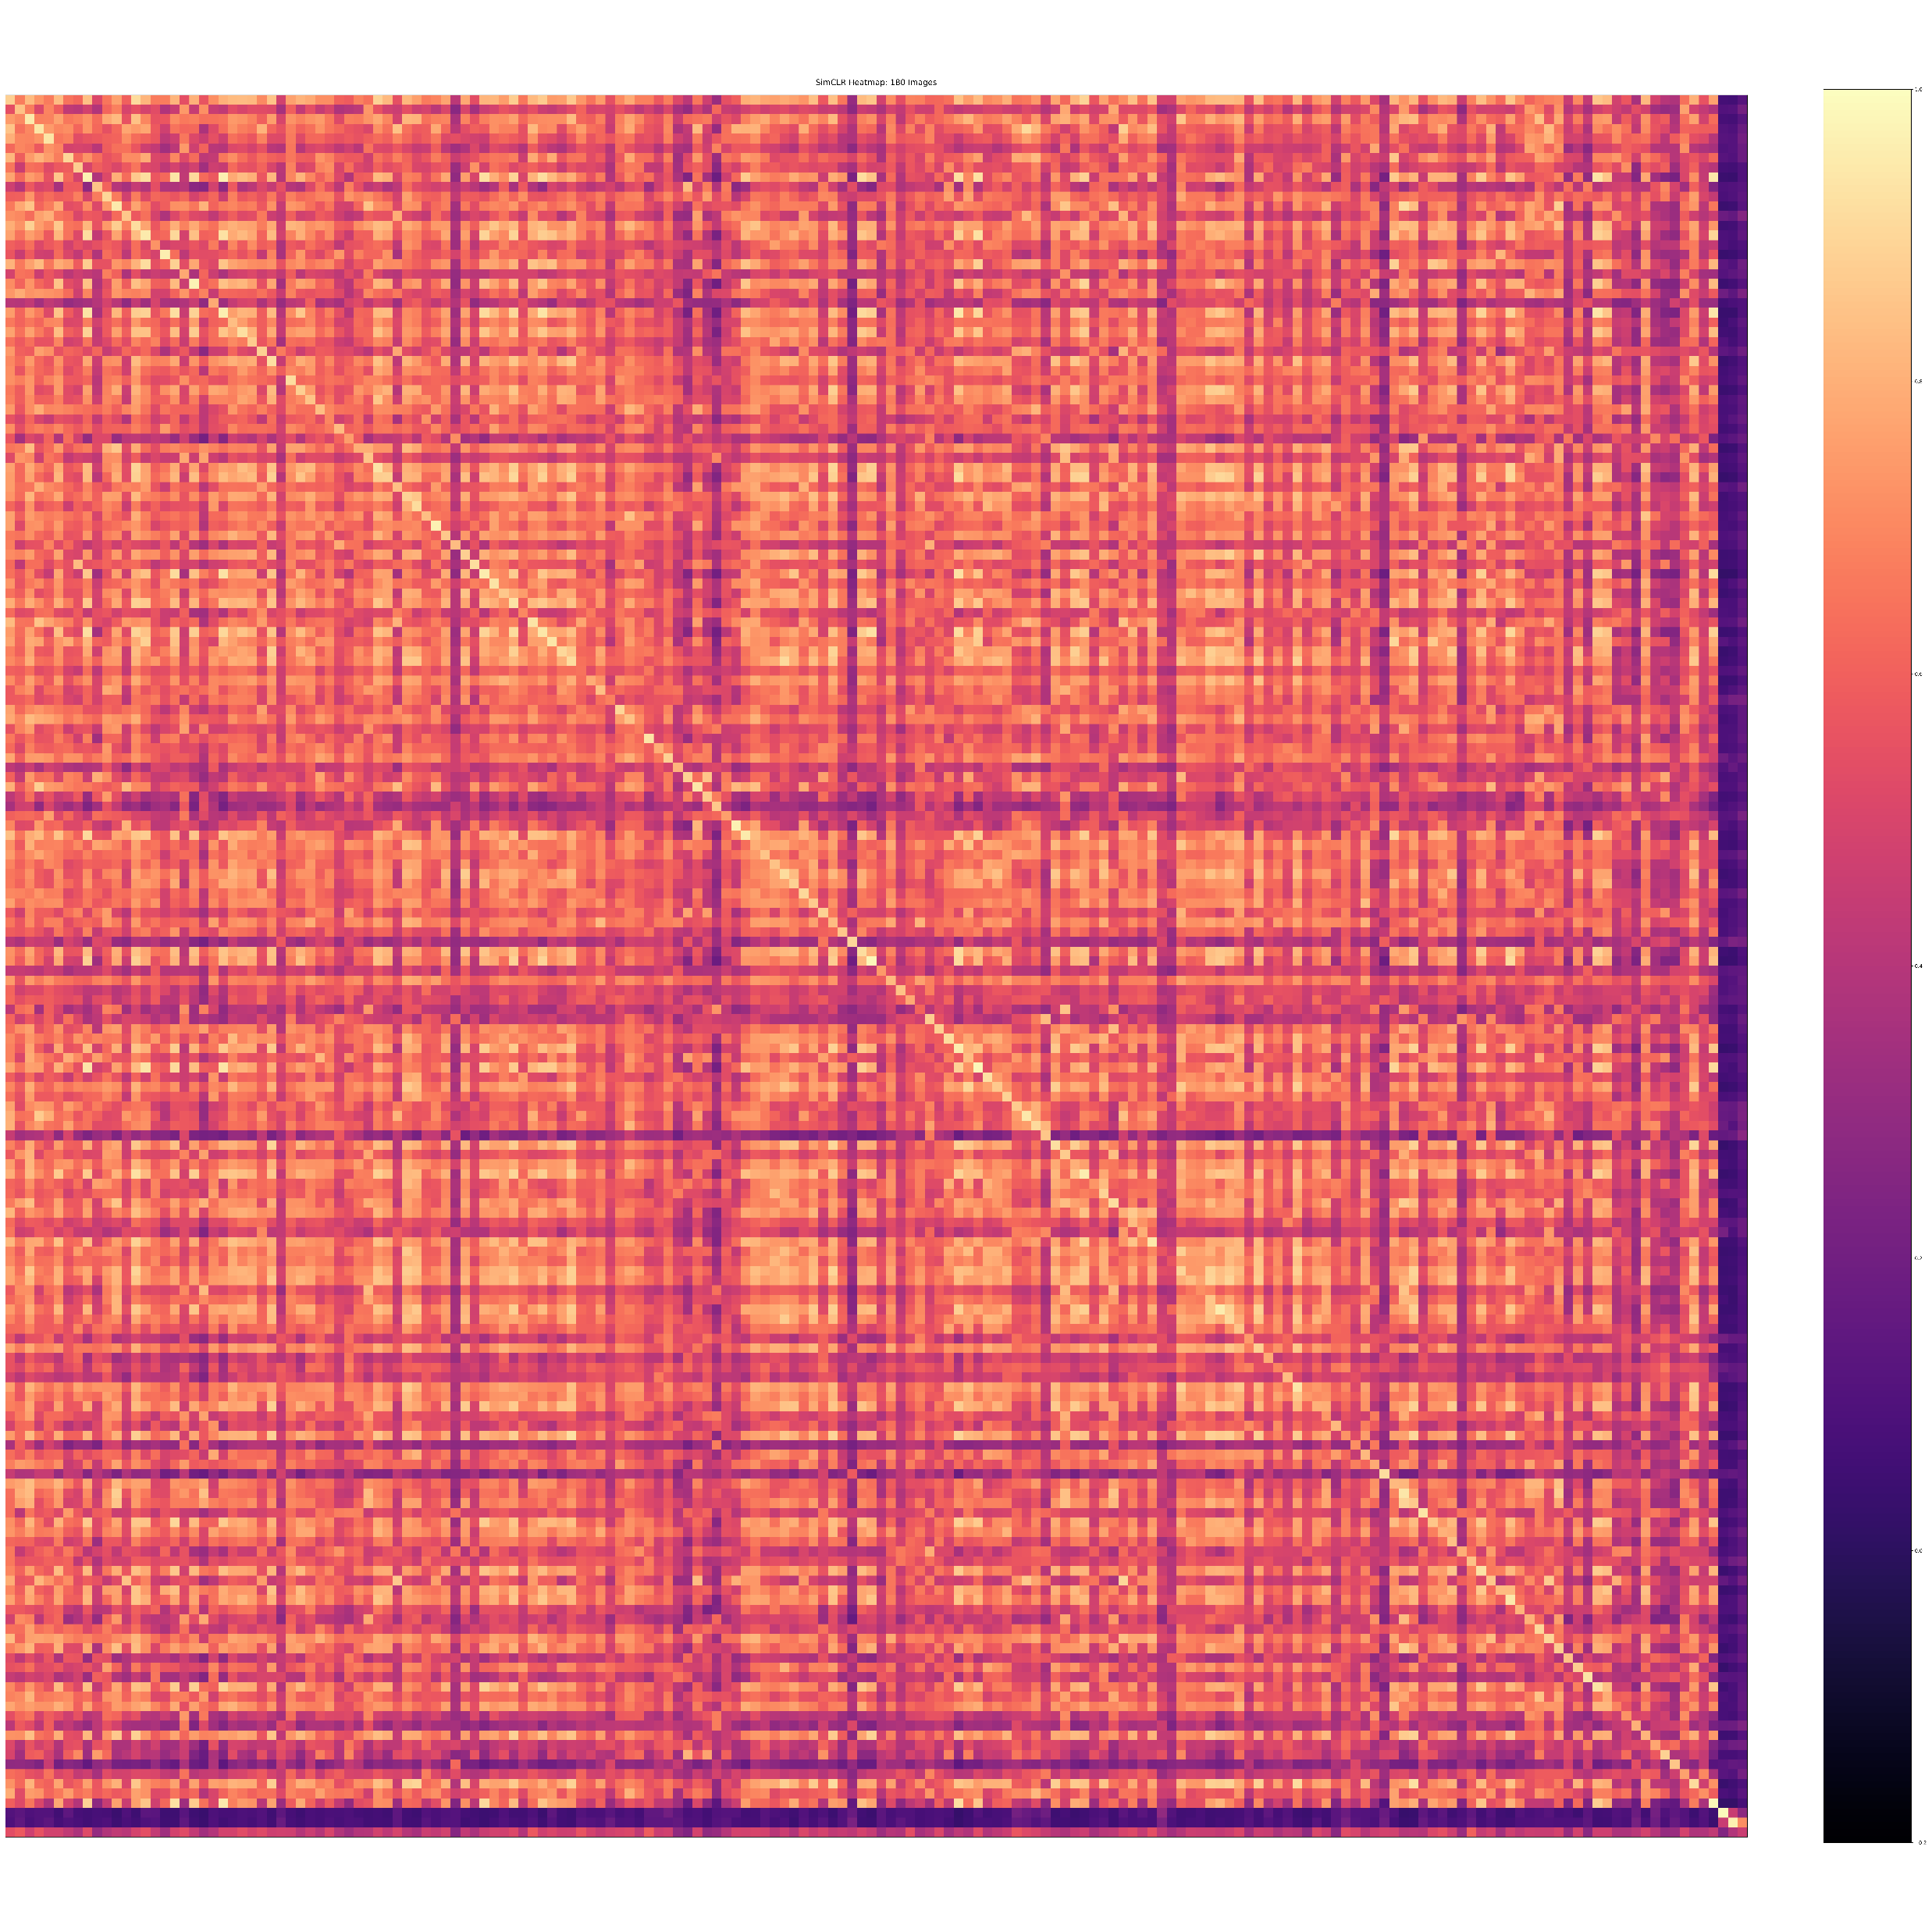
CASIA

Slide 11
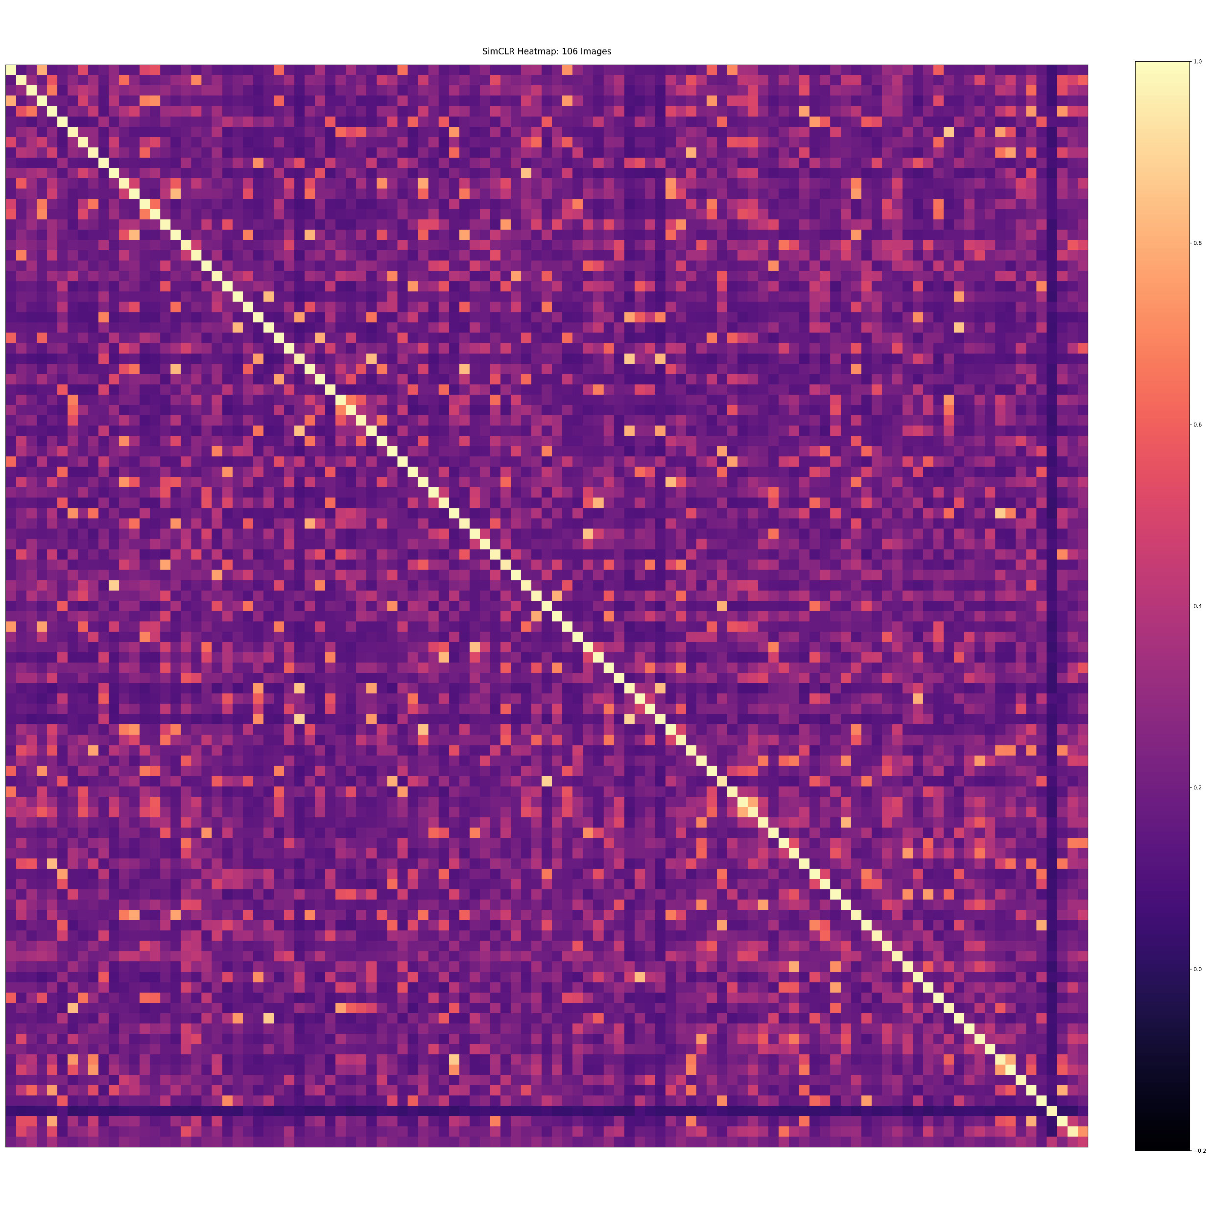
Train data

Slide 12
meeting
Generalisable augmentations?? Because we cant possibly train over all the transformations
Find the smaller set among the good and bad tranformations
Do on a smaller subset of trasnforms
Blurring, reject selective ones,
Think of cropping images with watermarks on bottom right or left
Firstly write down what we want to allow (or don’t)

